Slide 1

Wireless Networking
Ambuj Varshney
ambujv@nus.edu.sg

Slide 2
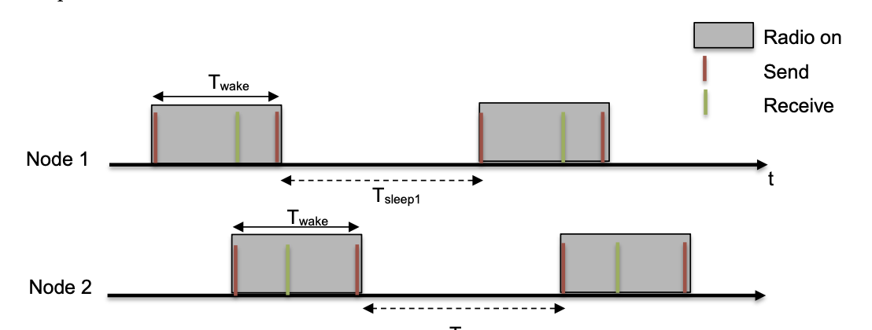
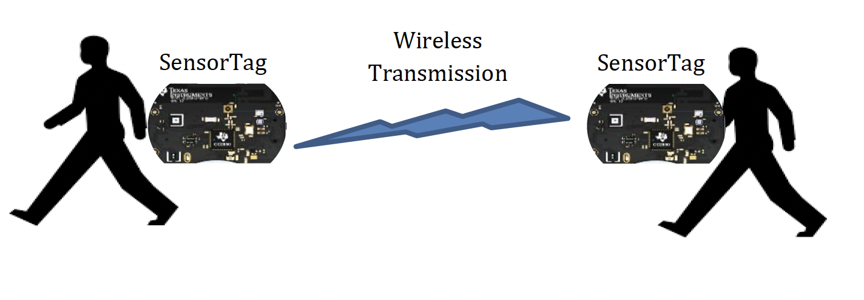
Discussion regarding the project
Deadline: April 26th April
Submission after deadline: No Penalty (Last date: 30th April)
Two tasks needs to be performed. Builds on previous assignments
To be submitted: Report, source code, demonstration, readme file

Slide 3
Roadmap of the lecture today
General course information and updates
Let us review what we had covered the last lecture
Routing Basics
Flooding
Reactive and Proactive routing

Slide 4
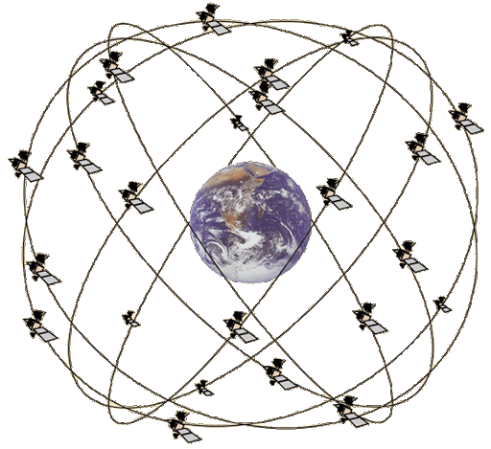
Overview of Global Positioning System
Satellites placed in Medium Earth Orbit (20,000 KM)
Orbit earth twice per day
Placed such that 4 are in view everywhere, always
31 total in orbit as of November 2020
Most recent launch November 5th 2020
Comparisons
LEO 200-2000 km, ISS at 340 km
GEO 35,000 km

Slide 5
What do you mean by the term localization?
Localization systems determine the physical coordinates of an electronic device such as IoT nodes, drones, mobile phones or a subject
These physical coordinates of electronic devices are:
Global - aligned with some externally meaningful systems like GPS
Relative - some “rigid transformation” (rotation, reflection, translation) away from a global coordinate systems
Localization indoors: goal is positioning things within a building
Where can I find X?
X: where am I located?
X and Y: are we near each other?

Slide 6
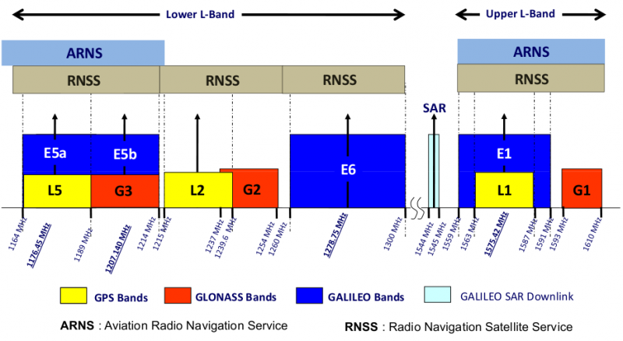
GPS PHY
GPS frequency
1.2 GHz and 1.5 GHz
10-15 MHz bandwidth
BPSK modulation
Signal has to travel 20,000 km, but most of that is through space
Tx power 25 Watts (44 dBm)
Rx sensitivity -140 dBm to -160 dBm (50 bps data rate)
~200 dBm total link budget

Slide 7
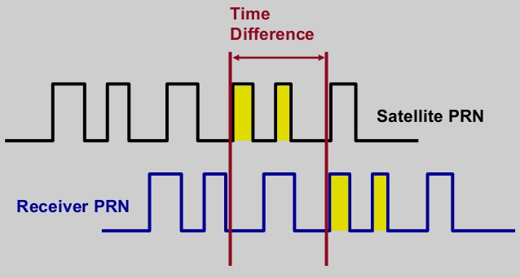
GPS transmissions
Each satellite sends a unique pseudo-random number sequence
Sequence repeats in time (over minutes) and is well-known
Position in signal is used to calculate time of flight

Slide 8
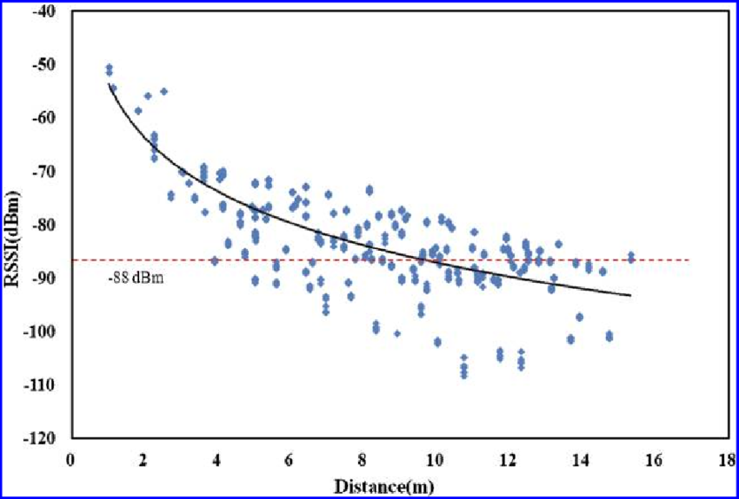
Problem with RSSI-based distance – not accurate
Pathloss is NOT only due to distance
RSSI is way worse at this than you hope it would be
Citation: literally everyone has made this figure at some point

Slide 9
Time of flight (also known as time of arrival, ToA)
Determine distance by knowing:
Exact position of infrastructure
Transmit time
Receive time
Signal velocity (i.e. speed of light)
Infrastructure transmits and device listens
Can happen all the time, but devices only listen when they want a position
Requires time synchronization between infrastructure and device
Synchronization must be good: 1 μs = 300 meters

Slide 10
Time difference of arrival (TDoA)
Device transmits and infrastructure receives transmission
Multiple infrastructure nodes receive at different times based on distance
Determine distance by knowing
Exact position of infrastructure
Time of arrival at two different locations
Signal velocity (i.e. speed of light)
Doesn’t require synchronization with infrastructure!
Still requires synchronization between infrastructure nodes
Does require device to transmit loud enough for infrastructure to hear it…

Slide 11
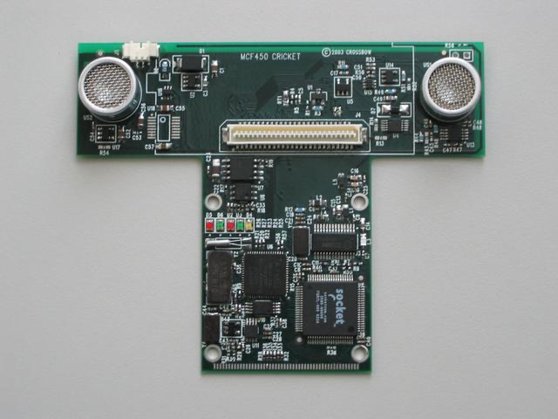
Time difference of arrival with different mediums
Exploit differences in speed, say RF and audio
Example: Cricket System [1]
In addition to a radio, each node also has a speaker and microphone
How does Cricket works?
Transmitter sends a radio message, waits some time (optionally) t_delay, sends audio “chirp” sound
Listener hears the radio signal, record time t_radio
Listener hears the audio signal, record time t_sound
[1] http://cricket.csail.mit.edu/

Slide 12
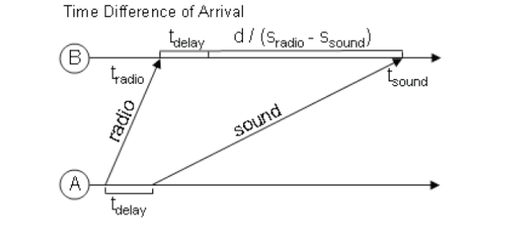
Time difference of arrival with different mediums
Time diff between signal arrival = d/S_{Sound} – d/S_{Radio} + t_{delay}
Works well in LOS environment
Cricket (uses ultra sound) can obtain close to cm accuracy
Requires additional hardware and works better with calibration

Slide 13
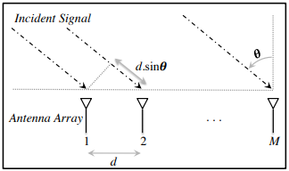
Angle of arrival (AoA)
Trilateration doesn’t only require distances, angles work
Antenna arrays can be used to determine the angle of an incoming signal
Allows the use of normal RF communication (WiFi or BLE)
BLE 5.1 includes AoA localization

Slide 14
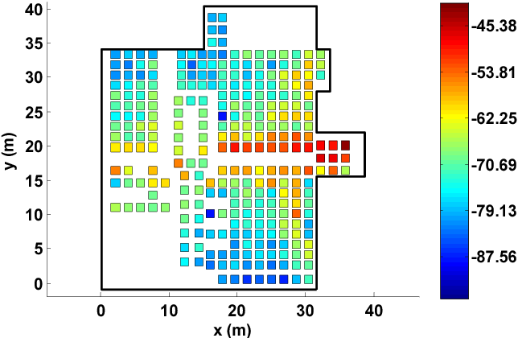
Fingerprinting overview
At setup time, for many locations throughout building
Measure signal strength to Access Point
Record measurement in a database with location
At run time, for the device that wants a location
Measure signal strength to Access Point
Look up measurement in database to get location

Slide 15
How to discover nodes or devices nearby
Scenarios for local discovery
You just enter a shopping mall. You would like to check if there is WiFi service. How does your mobile phone discover the presence of WiFi networks?
Small devices with low power network interface (e.g. ZigBee) are deployed in the surrounding and carried by humans. How can these devices discover other devices in range (in an energy efficient way)?

Slide 16
How to perform neighbor discovery?
Problem is “easy” to solve if there is no constraint and all nodes can be active all the time.
Challenge is to design a protocol that is energy efficient.
Two broad methods for local neighbor discovery:
Synchronous
Asynchronous

Slide 17
Synchronous neighbor discovery
All nodes are synchronized to the same clock/time.
Nodes wakeup periodically at same time to transmit/receive packets
Node A discovers node B when it hears a transmission from node B
Example:
Time divided into slots of 100ms and there is a global starting reference time t₀ sec
With a 10% duty cycle, period is 1s,
each node wakes up at t₀ + k sec for 100ms, where k = 0,1,2,3,4….
With a 1% duty cycle, period is 10s,
each node wakes up every t₀ + 10k sec for 100ms, where k = 0,1,2,3,4….

Slide 18
Drawbacks to synchronous neighbor discovery?
Synchronization can be expensive and periodically re-synchronization will be needed to correct for clock drift over time
As all nodes wakeup at the same time to transmit/receive, collision may increase if too many node transmit simultaneously

Slide 19
Asynchronous Protocols
Challenges:
No time synchronization
All nodes are resource constrained
Assumptions
Divide into time slots (e.g. 100ms)
Each device decides (randomly?) which time slots to wakeup to transmit/listen
How long will two such devices take to discover each other?

Slide 20
Birthday Paradox
In a group of N people, what is the probability that there is at least one pair of people who have the same birthday? (assume 365 days in a year)
In general, Prob = 1 – P(none of the N people have the same birthday)
N = 2, Prob = 1 – (364/365)
N = 3, Prob = 1 – (364/365)(363/365)
N = 4, Prob = 1 – ((364/365)(363/365)(362/365)
N = n, Prob = 1 – 365!/(365^{n}(365-n)!)
Example:
N = 2, Prob = 0.0027
N = 23, Prob = 0.5073
N = 50, Prob = 0.9704

Slide 21
“Birthday” Protocol
Easy to implement
Good average discovery latency but unbounded worst case

Slide 22
DISCO - Asynchronous neighbor discovery algorithm
Scheduling radio wake times at multiples of prime numbers to ensure deterministic discovery
Nodes can have different duty cycles
Version 0: A node i picks a prime number, say p_{i} and wakes up p_{i} timeslots, the duty cycle is (1/ p_{i}). In the worst case, two nodes p_{i} and p_{j} will meet after (p_{i} * p_{j}) timeslots.
Problem: what if both nodes pick the same prime number?
Version 1: A nodes i picks a prime number, say p_{i1} and p_{i2} (p_{i1} != p_{i2}), wakes up every p_{i1} and p_{i2} timeslots. The duty cycle is (1/p_{i1} + 1/p_{i2})
If both nodes pick the same pair of prime number:
Duty cycle ~ (p_{i1} + p_{i2})/ p_{i1} p_{i2}, Worst Case ~ p_{i1} p_{i2}
Dutta, Prabal, and David Culler. "Practical asynchronous neighbor discovery and rendezvous for mobile sensing applications." Proceedings of the 6th ACM conference on Embedded network sensor systems. 2008.

Slide 23
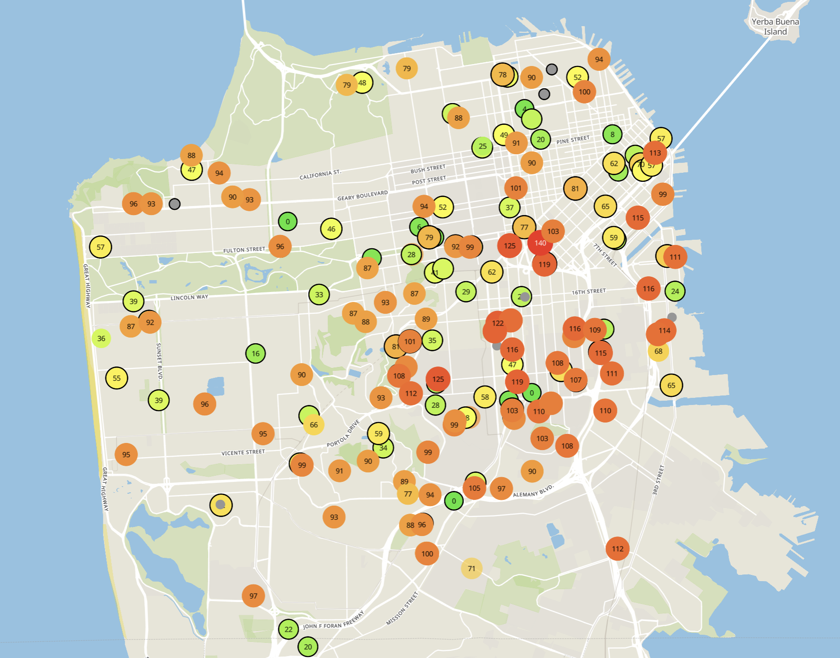
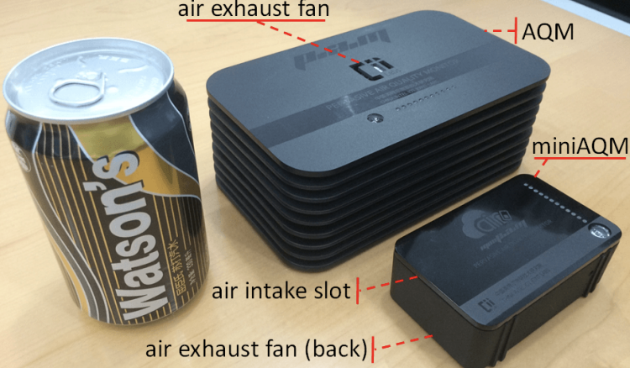
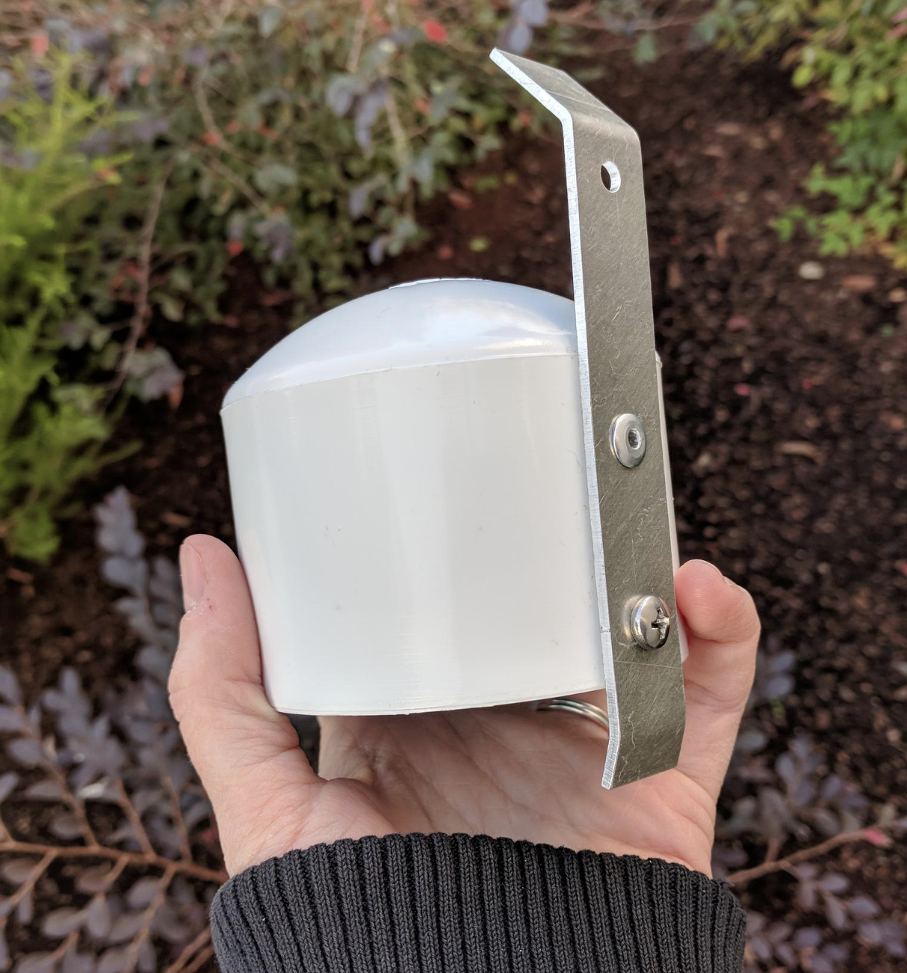
Example application: air quality monitoring
[1]
[2]
[2]
[1] Cheng et al. AirCloud: a cloud-based air-quality monitoring system for everyone. 2014. [2] Purple Air. 2019.

Slide 24
We need another network option
Requirements:
Wide area of coverage
Deploy fewer gateways
Low power
So we can deploy on batteries
Doesn’t need high throughput
Sensor data is relatively small

Slide 25
Long-range,low-data needs are not easily met
WiFi
4G
Higher Power & Higher Cost
3G
Data
Throughput
Bluetooth
2G
Low-Power Wide-Area Networks
BLE
Zigbee
Lower Power & Lower Cost
Range

Slide 26
Long-range, Low-power: design choices
How would you design PHY for long-range, low-power ?
Modulation
Unclear. Perhaps, not complicated or complex (simple devices)
Tx Power
High (much higher than 0 dBm)
Carrier Frequency Band
Low (something lower than 2.4 GHz, 915 MHz or lower?)
Data Throughput
Low (much lower than 1 Mbps)
Channel Bandwidth
Unclear. Likely smaller for lower frequency carrier.

Slide 27
Design a low-power wide-area network
Any particular MAC choices for lower power?
Diversity of devices in network
High power gateway, low power devices in star topology
Devices should be off whenever possible
Listen-after send for downlink
Remove requirements for synchronization
No TDMA access control if it can be avoided
Aloha, CSMA

Slide 28
Long-range CSMA is problematic
Long-range makes everything more challenging
Kilometers of range mean kilometers between devices
Detection of channel use is less reliable
Active research in clear channel assessment for LPWANs
Hidden terminal problem has a wider range
Might make RTS/CTS more important
Result: CSMA doesn’t dominate LPWANs like it does WLANs

Slide 29
LPWANs overview (common qualities)
Unlicensed 915 MHz band (902-928 MHz)
Higher power transmissions: ~20 dBm (100 mW)
Low data rate 100 kbps or less
Range on the order of multiple kilometers
Simple Aloha access control

Slide 30
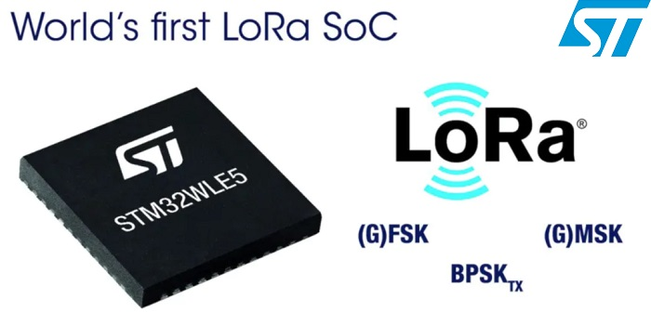
LoRaWAN
Open communication standard built with proprietary LoRa PHY
Operates in the unlicensed band
Low data rate (1-20 kbps) and long range (~5 km)
Most popular LPWAN protocol
Academic research and industry involvement

Slide 31
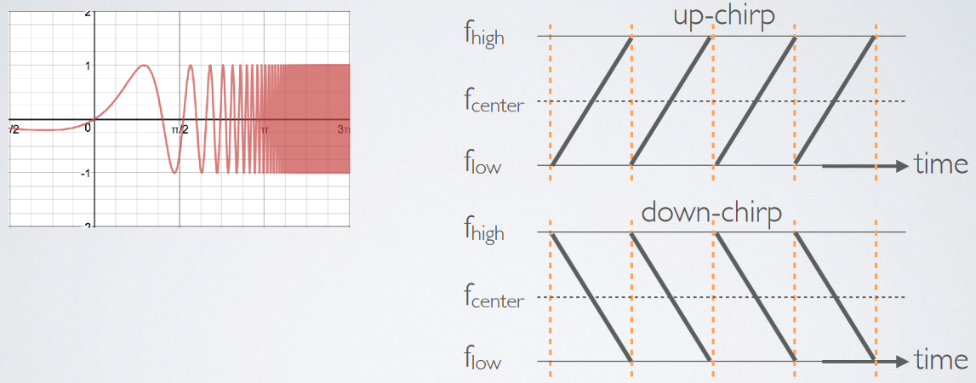
LoRa employs a different modulation scheme
Chirp Spread Spectrum (CSS): Modulation technique where frequency is varied linearly from lowest to highest within a channel

Slide 32
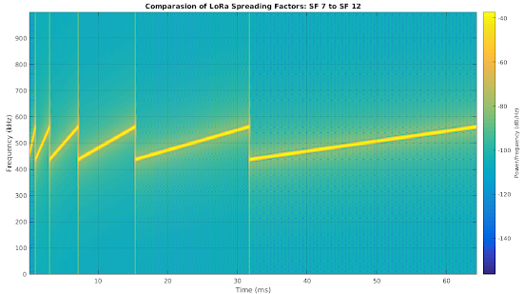
Spreading factor of CSS modulation
Spreading Factor is essentially the rate-of-change of frequency
Slope of the line
Lower values of spreading factor (steeper slope) are faster data rate
Important: different spreading factors are (mostly) orthogonal!
Two can overlap in time, space, and channel without a collision

Slide 33
LoRa data rates
Data Rate Index | Spreading Factor | Bit Rate
125 kHz Uplink Rates
0 | SF10, 125 kHz | 980 bps
1 | SF9, 125 kHz | 1760 bps
2 | SF8, 125 kHz | 3125 bps
3 | SF7, 125 kHz | 5470 bps
500 kHz Uplink Rates
4 | SF8, 500 kHz | 12500 bps
500 kHz Downlink Rates
8 | SF12, 500 kHz | 980 bps
9 | SF11, 500 kHz | 1760 bps
10 | SF10, 500 kHz | 3900 bps
11 | SF9, 500 kHz | 7000 bps
12 | SF8, 500 kHz | 12500 bps
13 | SF7, 500 kHz | 21900 bps
Data rate depend on channel in use, spreading factor
64-channel uplink
1-5 kbps data rate

Slide 34
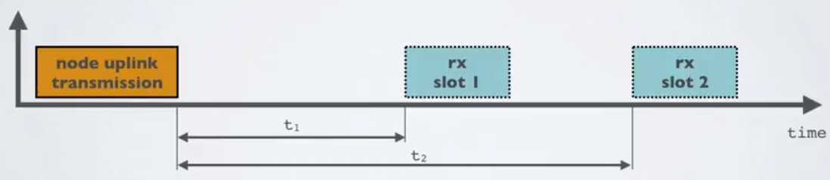
LoRaWAN MAC
Uplink: Aloha - transmit whenever
Randomly split across 64 uplink channels (reduced odds of collision)
Devices a different spreading factors also do not collide
Packets are very long though: up to 400 ms in duration
Downlink: listen-after-send (class A device)
Two windows for RX on different channels

Slide 35
LoRa link budget and transmission range
Typical TX power 20 dBm
Up to 30 dBm for 64-channel hopping
Up to 26 dBm for 8-channel hopping
Receive sensitivity -119 dBm/-146 dBm (highest SF)
Compare to -100 dBm for 802.15.4 and -95 dBm for BLE
Resulting range is kilometers in urban environments

Slide 36


LoRaWAN network providers
Network provides with a deployment of gateways
The Things Network (predominantly in Europe)
Helium
Any can buy and install their own gateway, which serves everyone
Microtransactions to pay for communication

Slide 37

Sigfox
Very low-rate (600 bps), very long-range (10+ km) communication
Star-topology networks, with always-listening gateways
Any number of low-power end devices
Uplink-focused communication
Applications: very low-rate metering

Slide 38
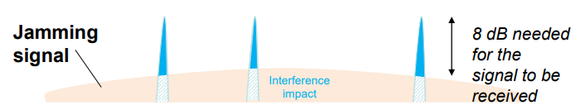
Sigfox PHY
Unlicensed-band communication
Europe 868 MHz. US 902-928 MHz (915 MHz band)
Ultra-narrowband 600 Hz (100 Hz Europe) channel bandwidth
Detection only needs to occur at very specific frequency
Helps improve signal-to-noise ratio

Slide 39
Sigfox unbalanced uplink and downlink
Uplink
600 Hz bandwidth, 600 bps, DBPSK
Downlink
1.5 kHz bandwidth, 600 bps, GFSK
Particularly optimized for Europe
Uplink on 1% duty cycle channel, up to 14 dBm
Downlink on 10% duty cycle channel, up to 27 dBm
Works fine in US too
Gets more power (24 dBm up is typical, up to 32 dBm down) and more range

Slide 40
Sigfox link budget
Why transmit at 100-600 bps?
For greatly increased link budget
Link budget: 150-160 dBm
Assuming Tx at ~20 dBm
Means Rx Sensitivity of -130 dBm (10 dBm better than LoRaWAN)
Resulting range: 10-15 km in urban environments
Except that buildings lead to dead spots in range

Slide 41
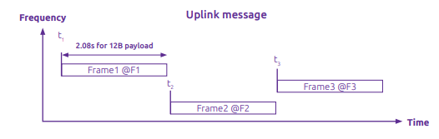
Sigfox MAC
Aloha-style access control (send whenever)
No acknowledgements!
Send message three times for increased reliability
Then listen for downlink at a set period later on a known frequency

Slide 42
Sigfox deployments
Proprietary network with managed deployment
Like cellular networks
Sigfox deploys networks and transports data
140 uplink messages plus 4 downlink message per day
Connectionless communication
Devices are registered with the networks
Keys are provided in the software image
Any deployed Sigfox gateway can collect transmitted data
Enables mobile applications

Slide 43
IEEE standard for LPWANs
n.b.
802 = “area networking”
.3 = “LANs”
.11 = “Wireless LANs”
.15 = “PANs”
802.11ah (HaLow) standard in 2016
First real hardware in 2020
Still not in real-world use yet
Focus on the indoor-to-outdoor scenario
Medium range (maximum 1 km)
915 MHz communication
NOT interoperable with other 802.11 access points and devices
Theoretically up to 356 Mbps
Practically, most devices are expected to implement 150 kbps to 8 Mbps

Slide 44
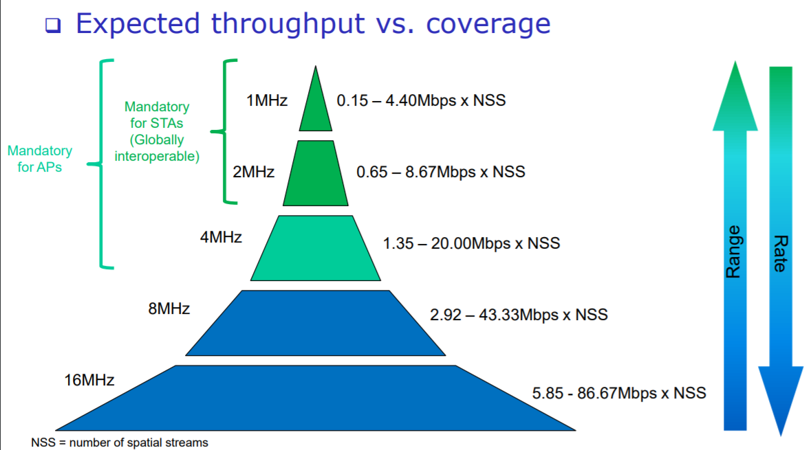
802.11ah allows multiple bandwidth allocations

Slide 45
Roadmap of the lecture today
General course information and updates
Let us review what we had covered the last lecture
Routing Basics
Flooding
Reactive and Proactive routing

Slide 46
Routing

Slide 47
What do you mean by routing?
You know destination, have a packet, how do you send this packet towards the destination node ? This is the routing question.
Routing is trivial if all nodes are connected to each other
Problem: if N nodes, need N(N-1) or O(N²) (uni-directional) links
Simple techniques: broadcast, tree structures
Mesh techniques: understand available routes and select a “good” one

Slide 48
Performing routing in the wired networks
Number of links can be reduced very significantly with one “BIG” switch with N links and routing is still simple
Problem: If N is large and nodes can be far apart (think of the Internet)
Adding more switches/routers would reduce the size of the switches/routers needed and allow network to grow
Think Internet!
But Routing will be more complex!

Slide 49
Performing routing in the wireless networks
Routing protocols are complex, hard to maintain/debug and incurred significant overhead. More so for wireless networks.
In practice, wireless network deployments are single-hop and routing is trivial. All stations/devices communicating directly with base stations
Example: WiFi, Cellular Network, LoRa
Can one-hop communication be always sufficient by using sufficiently long range radio and large number of base stations?
Why multi-hop routing?
Better in terms of reach/coverage for the same number of base stations
Provides more routes, potentially more robust

Slide 50
For the same distance, is it better to have direct or multi-hop path?
A
B
A
C
D
E
B
Which option is better?
Typically, a single-hop is considered better

Slide 51
But, for energy Consumption …
Is multiple-hop transmission more energy efficient than a single-hop ?
Let us Recall the free space model: Pr = C P_{t} / dª (C = constant)
Transmission over a distance d, let minimum received power needed be P₀
1 transmission to cover distance d, transmission power (P₁) needed is
P₀ = C P₁ / dª or P₁ = P₀/C * dª
N transmissions to cover distance d, transmission power needed (P_{N}) per hop is
P₀ = C P_{N} / (d/N)ª , or P_{N} = P₀ /C * (d/N)ª
Total transmission power is N P_{N} = N P₀ /C * (d/N)ª
Which approach (1 transmission vs N transmissions) is more energy efficient?

Slide 52
What are the simplest routing solutions?
Broadcast
The link-layer solution for everything
Star topology
Only one location to send to: parent
Single parent needs to store information about all children
Addresses, schedules, etc.
Tree topology
Two choices: send to descendent or send to parent
Each parent needs to store information about all children beneath it

Slide 53
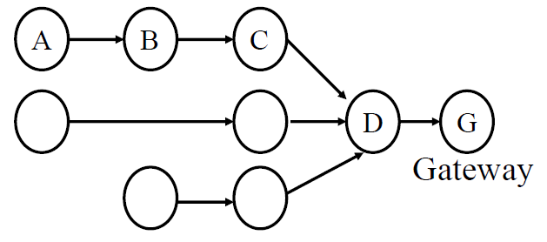
Many-to-one routing
Tree optimization for sensor networks
Keep all devices except the “gateway” as simple as possible
Each device only needs to remember hop to gateway
If gateway wants to send message back, it must include a full hop path

Slide 54
Mesh Routing
Formed by a network of static wireless nodes
Mesh topology makes routing question more complicated
Multiple hops in a route
Multiple routes between source and destination
Becomes a graph theory question based on cost metric
B
C
A
D
F
E

Slide 55
Roadmap of the lecture today
General course information and updates
Let us review what we had covered the last lecture
Routing Basics
Flooding
Reactive and Proactive routing

Slide 56
What is the mesh equivalent of broadcast?
Flooding is the mesh equivalent of broadcast (communicate to all)
Each node sends information to every other node in the mesh
Eventually the packets will reach the desired destination
Goal: get information to all nodes
This is the problem of “data dissemination”
Problem: difficult in Mesh topologies
Packet loss, retransmission delays
Question: How do we make flooding stop?
Question: Is it really routing?

Slide 57
What is the mesh equivalent of broadcast?
Flooding is the mesh equivalent of broadcast (communicate to all)
Each node sends information to every other node in the mesh
Eventually the packets will reach the desired destination
Goal: get information to all nodes
This is the problem of “data dissemination”
Problem: difficult in Mesh topologies
Packet loss, retransmission delays
Question: How do we make flooding stop?
Question: Is it really routing?

Slide 58
What is the mesh equivalent of broadcast?
Flooding is the mesh equivalent of broadcast (communicate to all)
Each node sends information to every other node in the mesh
Eventually the packets will reach the desired destination
Question: How do we make flooding stop?
Maximum retransmissions counter on each packet
Decrement at each hop. Drop packet when it hits zero
Need some guess for how many hops to destination
Keep some history of recently flooded packets
Don’t retransmit a recently sent packet
Question: Is it really routing?

Slide 59
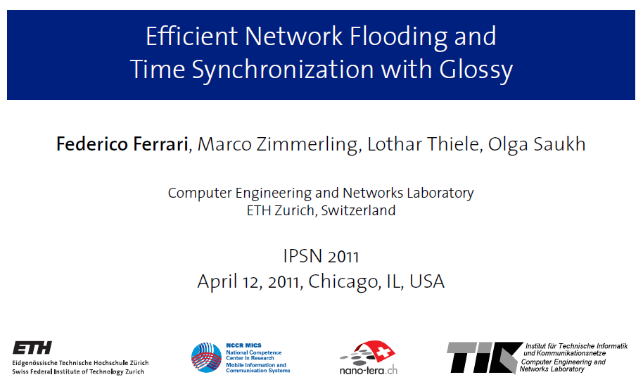
Glossy: what if we expand broadcast range by having multiple nodes participate?

Slide 60
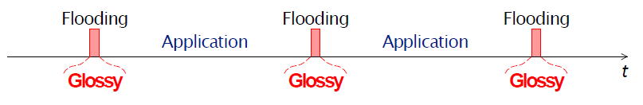
Glossy key techniques
Temporally decouple network flooding from application tasks
Exploit synchronous transmissions for fast network flooding

Slide 61
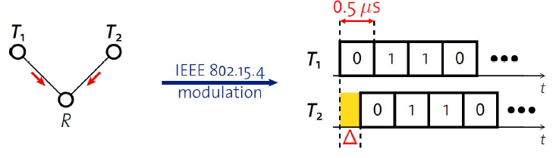
Synchronous transmissions
Multiple nodes transmit same packet at same time
R can receive packet with high probability if Δ is small
May even improve probability of reception (more energy at receiver)
500 ns is 1/32 of a symbol for 802.15.4 (chip duration)

Slide 62
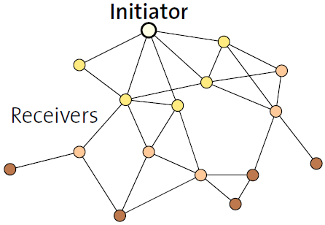
Fast packet propagation in Glossy

Slide 63
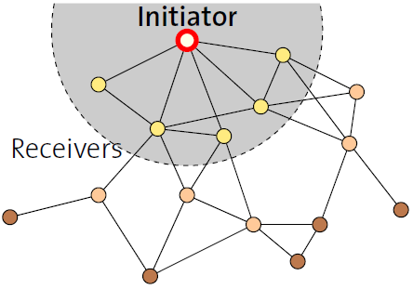
Fast packet propagation in Glossy

Slide 64
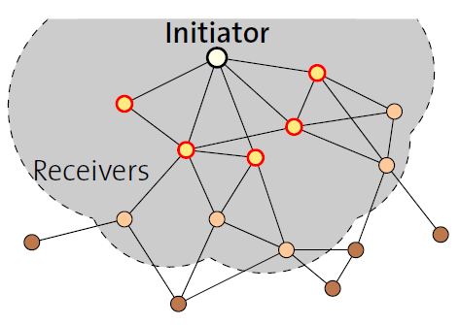
Fast packet propagation in Glossy

Slide 65
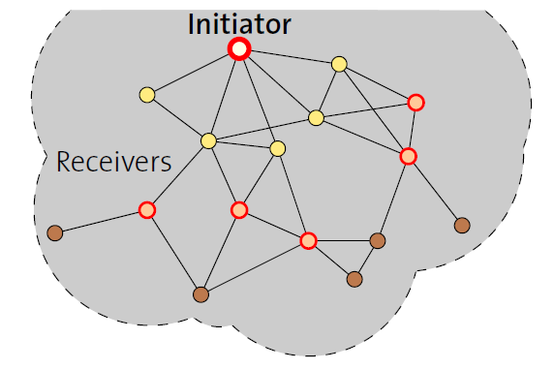
Fast packet propagation in Glossy

Slide 66
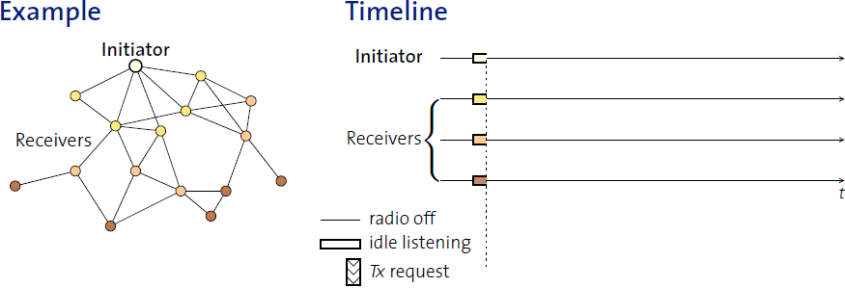
Glossy details
When Glossy starts
All nodes turn on radios to receive

Slide 67
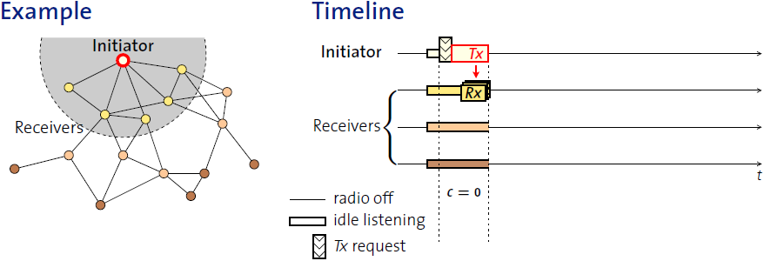
Glossy details
Initiator
Set relay counter in packet, C = 0
Broadcast packet

Slide 68
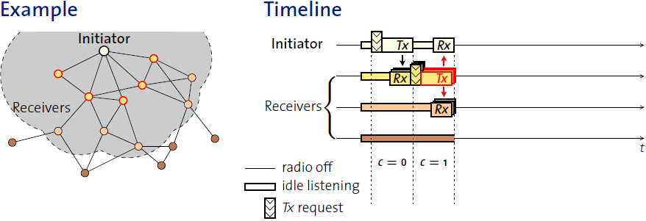
Glossy details
At packet reception:
Increment relay counter C
Transmit synchronously (at a fixed period after the reception)

Slide 69
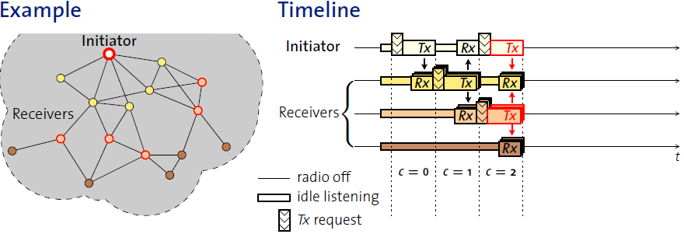
Glossy details
At packet reception:
Increment relay counter C
Transmit synchronously (at a fixed period after the reception)

Slide 70
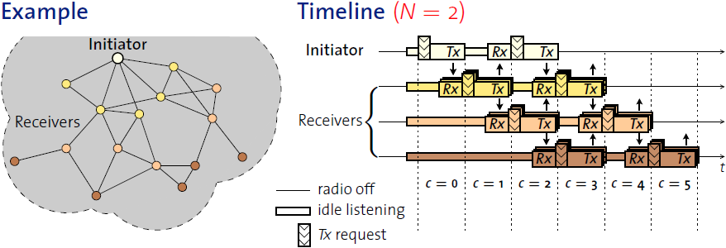
Glossy details
Stop rebroadcasting and turn off radio when
Already transmitted N times
Networks pick N for reliability/energy tradeoff

Slide 71
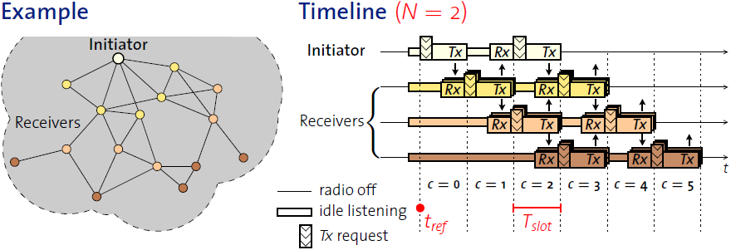
Glossy details
T_{slot} is constant by design
Needs to be to make constructive interference work
Beginning of slot (t_{ref}) provides synchronization point
As a bonus, all nodes are synchronized after flooding event

Slide 72
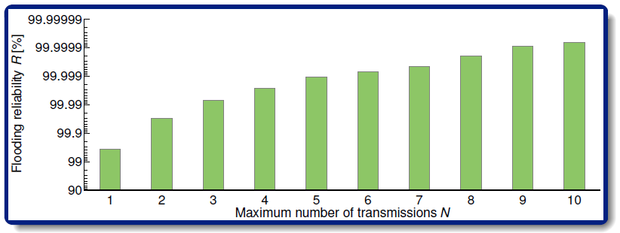
Glossy implementation
Device must be able to have tight time bounds on rx/tx
500 ns wiggle room maximum
Includes receive, processing, transmission
Need to pick an N for reliability

Slide 73
Roadmap of the lecture today
General course information and updates
Let us review what we had covered the last lecture
Routing Basics
Flooding
Reactive and Proactive routing

Slide 74
Routing in wireless mesh and routing metrics
What are some possible metric to make routing decisions?
Hop Count
Delay
Reliability
Energy
Other?

Slide 75
Reliability as a cost metric
Link quality can very from node to node
Fewest hops might not be the “fastest” or “most reliable” path
ETX: minimize “expected transmissions”
Measure link quality over time to determine each link’s reliability
B
C
A
D
F
E

Slide 76
Routing metrics for internet of things
Some important consideration: low-power, energy efficiency, duty cycled operations of the radio transceivers
Each device needs to decide if a link (to another node) is available
How can this decision be made?
Usually through some form of measurements
A node sends beacon and other nodes check if the beacon can be received

Slide 77
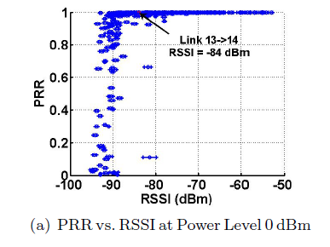
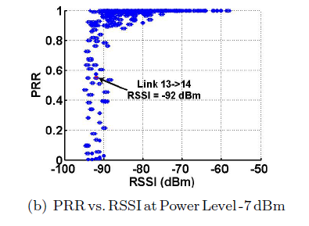
Low-power wireless links: PRR, RSSI
PRR – Packet Reception Ratio
RSSI – Received Signal Strength Indicator
Kannan Srinivasan and Philip Levis, “RSSI is Under Appreciated,” EmNets 2006.

Slide 78
Measuring Low-Power Wireless Link Quality
To measure PRR,
Receiver assumes that a transmitter sends S packets over a period of time T sec
In T sec, record the number of packets received from transmitter, let this be R
PRR = R/S
Example:
T = 1sec, S=100 (if R=95, PRR=0.95)
T= 10sec, S=100 (if R=55, PRR=0.55)
T= 100s, S=10 (if R=8, PRR=0.8)

Slide 79
Measuring Low-Power Wireless Link Quality
Trade-off between communication cost and reaction time
Assume ZigBee radio is used (250Kbps), each transmission takes 1ms (~250bits, ~30bytes) and link measurement probes should not collide
If T=1s, S=100
Measurement takes up 10% of bandwidth 1 node
If there are 10 nodes, 100 probes need to be transmitted in 1 sec (100% of bandwidth used only for measurement!)
If T=100s, S=10
Measurement takes up very little bandwidth
Is S too small?
If there is a change in link quality, how long does it take to notice?
What are “good” values for T and S?

Slide 80
Who are my neighbors?
In order to reduce memory and computation cost, neighbor table tends to be small (e.g. 6 – 10)
How many neighbors are sufficient?
Only keep track of “good” neighbors

Slide 81
Who are my neighbors?
Possibility of network partition
Links within each room is good
The one link between the 2 room is weak
If all nodes select the best links, there will be no connection between rooms 1 and 2
Room 1
Room 2

Slide 82
Expected number of transmissions: ETX
ETX (expected transmissions) is a commonly used routing metric
Consider the path A -> B -> C
Packet reception ratio (PRR)
A -> B is 0.8, ETX = 1/0.8 = 5/4
B -> C is 0.5, ETX = 1/0.5 = 2
Path ETX (A -> B -> C) is 5/4 + 2 = 13/4
A
B
C

Slide 83
Performing routing using the shortest path
Many practical routing algorithms are based on the notion of shortest path between two nodes
Each link is assigned a positive number called its length
A shortest path routing algorithm routes each packet along the minimum length (or shortest) path between the source and destination
If length is always 1, then shortest path becomes minimum hop routing
By defining the length using other metrics like cost, delay etc, other paths can be obtained

Slide 84
Classification of the routing protocols
The existing routing protocols can be classified as:
Proactive: When a packet needs to be forwarded, the route is known
Reactive: Determine a route only when there is data to send

Slide 85
Reactive routing
Build up a map of the routes through a network
Hopefully the “optimal” routes
Map routes in reaction to a packet arrival
Sensor devices are slow and limited
Most likely to resend to same prior address
Discover a route when it is needed, then cache for next time

Slide 86
Distance-Vector
Keep routes as “next hops” rather than full routes
AODV uses this method (DV for Distance Vector)
Can be combined with proactive techniques too
Each router periodically informs neighbors of its shortest paths to each destination (in terms of hop count)
Routers choose the best route available
Old next-hop it was already aware of
New next-hop through neighbor (with cost of their hops + 1)

Slide 87
Ad-hoc On-demand Distance Vector Routing (AODV)
On-demand: Construct routes only when needed
Routing table
Destination node -> Next hop
Store only next hop instead of full route
All routers along the path must also have Destination->Next mappings
Also keep hops-to-destination and last-seen-destination-sequence-number
Route discovery
Upon demand: check table
If not cached send Route Request (RREQ) via Flooding
Route is unknown, so flooding is needed

Slide 88
AODV Route Requests (RREQs)
Request ID | Source Address | Destination Address | Source SeqNo | Destination SeqNo | Hop Count
Request ID identifies this RREQ
Used to discard duplicates during flooding
Sequence Numbers are per-device, monotonically increasing
Used as a notion of “how recently” device has been seen
Source SeqNo is the source’s most recent sequence number
Destination SeqNo is the most recently seen from the destination by the source. (Defaults to zero)
Hop Count is the number of hops this request has taken
Starts at 1 and incremented by each transmitter along the path

Slide 89
Example AODV RREQ (A to F)
Request ID | Source Address | Destination Address | Source SeqNo | Destination SeqNo | Hop Count
A wants to find a route to F, so it sends out an RREQ
B
C
A
D
F
E

Slide 90
Example AODV RREQ (A to F)
Request ID | Source Address | Destination Address | Source SeqNo | Destination SeqNo | Hop Count
1 | A | F | 1 | 0 | 1
B and D also opportunistically add a routing table entry for A
B
C
A
D
F
E

Slide 91
Example AODV RREQ (A to F)
Request ID | Source Address | Destination Address | Source SeqNo | Destination SeqNo | Hop Count
1 | A | F | 1 | 0 | 2
B goes first via some access control protocol (D also in contention)
A and D ignore duplicate Request ID C opportunistically adds a routing table entry to A
B
C
A
D
F
E

Slide 92
Example AODV RREQ (A to F)
Request ID | Source Address | Destination Address | Source SeqNo | Destination SeqNo | Hop Count
1 | A | F | 1 | 0 | 2
D goes next by some access control protocol (C also in contention)
A, B, and C ignore duplicate Request ID E and F opportunistically adds a routing table entry to A
B
C
A
D
F
E

Slide 93
Example AODV RREQ (A to F)
Request ID | Source Address | Destination Address | Source SeqNo | Destination SeqNo | Hop Count
1 | A | F | 1 | 0 | 3
C and E repeat this process with Hop Count 3 (but everyone ignores them)
B
C
A
D
F
E

Slide 94
AODV Route Response (RREP)
Source Address | Destination Address | Destination SeqNo | Hop Count
Reply is sent unicast back to the source via newly constructed route
Each node along the way already knows the route back
Includes recent destination sequence number as a sense of recency
No need for source sequence number anymore

Slide 95
Example AODV RREP (F to A)
Source Address | Destination Address | Destination SeqNo | Hop Count
F | A | 7 | 2
F sends response back to A via D
D opportunistically adds a routing table entry for F
B
C
A
D
F
E

Slide 96
Route maintenance in AODV
If a link in the routing table breaks, all active neighbors are informed with Route Error (RERR) messages
After some number of retransmissions and timeouts
RERR contains destination address that broke
Nodes receiving RERR can start RERQ for destination address
Which lets them find a new path through the network
And updates everyone’s cached next-hops

Slide 97
Tradeoffs for reactive routing
Upside: no transmissions unless there is demand
Routes might appear, disappear, reappear, but no need to update if no one actually wants to transmit anything
Downside: large, variable delay when actually sending a packet
Full RREQ/RREP protocol before data can actually be sent
Route might have broken at some point
So data will be sent based on cached information
RERR will occur
RREQ/RREP will occur
Then data will be sent again

Slide 98
Proactive routing
Alternative to reactive is to know the routes ahead of time
Periodically query for the possible routes in the network
Save all routes that are important (maybe just all routes?)
Also redetermine routes whenever topology changes (nodes join/leave)
Upside: when a packet arrives, route to destination is already known
Downside: requires more memory and effort on part of routers
Wastes some network bandwidth on checking for route changes

Slide 99
RPL

Slide 100
Routing Protocol for Low Power and Lossy Networks (RPL)
● Distance Vector (DV) protocol
Requires that a router to inform its neighbors of topology changes periodically
Each node maintains a vector (table) of minimum distance to every node
● Source Routing Protocol
Allows a sender of a packet to partially or completely specify the route the packet takes through the network

Slide 101
Routing Protocol for Low Power and Lossy Networks (RPL)
(Directed Acyclic Graph)

Slide 102
Routing Protocol for Low Power and Lossy Networks (RPL)

Slide 103
Routing Protocol for Low Power and Lossy Networks (RPL)

Slide 104
RPL: Control Messages
DODAG Information Solicitation (DIS): used to solicit a DODAG Information Object from a RPL node.
DODAG Information Object (DIO) - The DODAG Information Object carries information allows a node to discover a RPL Instance, learn its configuration parameters, select a DODAG parent set, and maintain DODAG
RPL nodes transmit DIOs using a Trickle Timer.
Destination Advertisement Object (DAO): The Destination Advertisement Object (DAO) propagates destination information Upward along the DODAG.
DAO-ACK

Slide 105
Roadmap of the lecture today
General course information and updates
Let us review what we had covered the last lecture
Routing Basics
Flooding
Reactive and Proactive routing

Slide 106
Wireless Networking
Ambuj Varshney
ambujv@nus.edu.sg
Notes:
++ Thank you for inviting me to give this talk
++ In this talk, I will present a pathway that can enable us to make wireless embedded systems ubiquitous. I will describe my previous research efforts that tackle the critical challenges that limit the growth of wireless embedded systems. These are related to the growing energy asymmetry that exists between sensing, computation and communication blocks on these platforms.
++ Finally, I will conclude my talk by covering the research agenda that I would like to work on as a faculty member.

